Slide 1


Day 3: OOP, Libraries & Mini-Project
Sean Wong
2025/08/05

Slide 2


CONTENTS
01.
02.
OOP Foundations
Standard Libraries
03.
04.
Mini Projects
Wrap-up

Slide 3



01
OOP Foundations

Slide 4


Objects vs Dictionaries
Introduction to OOP
01
In OOP, objects are instances of classes. Classes act as blueprints, defining the structure and behavior of objects. This allows you to create multiple objects with similar properties and methods.
Objects and Classes
02
Object-oriented programming (OOP) is a paradigm that uses objects and classes to structure code. It promotes modularity and reusability, making complex programs easier to manage and maintain.
Example Comparison
03
Compare a dictionary storing car details with a Car class. The class includes methods like drive() and refuel(), demonstrating how OOP bundles data and behavior into a single, organized structure.

Slide 5

Crafting Your First Class
1
Class Syntax
To define a class in Python, use the class keyword followed by the class name and a colon. The __init__ method initializes the object’s attributes, and self refers to the instance itself.
2
Example Class
Create a Person class with attributes name and age. Add a greet() method to print a personalized greeting. This example shows how to instantiate objects and call methods.

Slide 6

Car Class Lab Exercise
Exercise Overview
Instantiation
Build a Car class with attributes make, model, and year. Add a display_info() method to print a summary and an age() method to calculate the car’s age using the current year.
Create Car objects using the class. Pass make, model, and year as arguments to the constructor. Call display_info() and age() methods on these objects.
Method Implementation
Challenge Extension
Implement the display_info() method to neatly print car details. Use the datetime module to get the current year and calculate the car’s age in the age() method.
Optional challenge: add a method to update the car’s mileage. This exercise reinforces attribute access, method definition, and basic datetime usage.

Slide 7
02
Standard Libraries

Slide 8


Random Datetime Math Trio
Standard Libraries
Python’s standard libraries provide powerful tools without needing external packages. The random module generates random numbers, datetime handles dates and times, and math offers functions like sqrt and factorial.

Slide 9

Optional Powerhouses
1
2
3
Pandas for DataFrames
Requests for Web Data
Example Usage
Pandas is a powerful library for data manipulation. It allows you to create DataFrames, which are table-like structures for storing and analyzing data. Easily load, manipulate, and visualize data with pandas.
The requests library simplifies fetching data from web APIs. Use it to make HTTP requests and retrieve data in formats like JSON. Combine requests with pandas to fetch and analyze web data seamlessly.
Fetch a JSON joke using requests, convert it to a DataFrame with pandas, and print the result. This demonstrates how to integrate these libraries for practical data handling tasks.

Slide 10

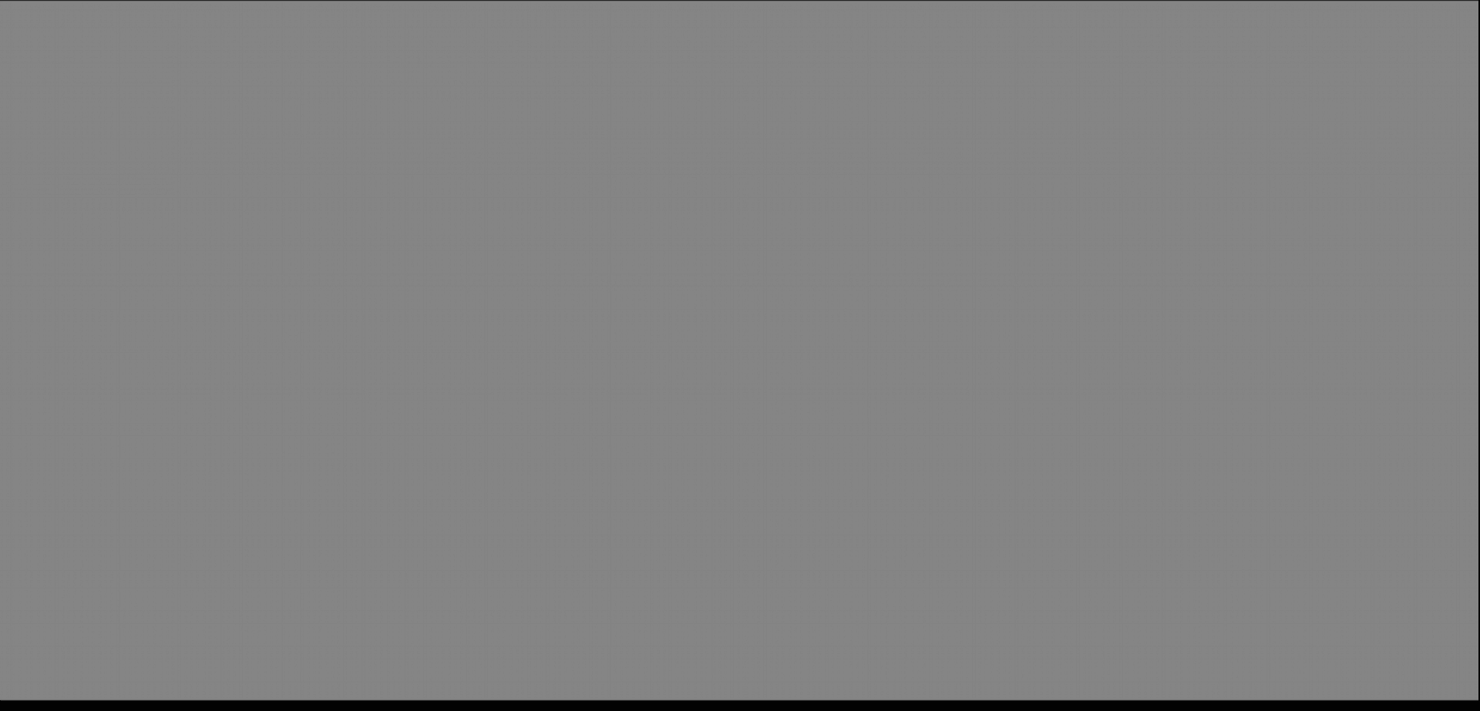



Library Drill Set
01
02
Exercise 1: Random Dice Roll
Exercise 2: Current Date and Time
Use the random module to roll two dice and print the sum. This exercise demonstrates basic random number generation and simple arithmetic operations.
Use the datetime module to display the current date and time in a readable format. This helps you understand how to work with dates and times in Python.

Slide 11
03
Mini Projects

Slide 12


Quiz Game Architecture
Project Overview
Game Logic
Design a text-based quiz game using OOP principles. Store Question objects in a list, shuffle them with random, and track the user’s score.
Implement the game loop to display questions, get user input, and update the score. Use a list to store Question objects and shuffle them before starting the game.
Class Design
Enhancements
Create a Question class with attributes for the question text, correct answer, and possible choices. Add a method to check if an answer is correct.
Add optional enhancements like displaying the final score as a percentage or using pandas to store and display results.

Slide 13

Utility App Blueprint
1
Project Overview
Build a CLI budget tracker that loads a CSV ledger, allows users to add income and expenses, calculates the running balance, and saves changes back to the file.
2
File Handling
Use the csv module to read and write the ledger file. Implement functions to add entries and update the balance.
User Interface
3
Create a simple text-based interface with menu options to add income, add expenses, display the current balance, and save changes.

Slide 14


Capstone Build Session
Build and Test
Allocate time for learners to build their chosen project. Encourage them to break it into smaller functions or classes, test each part individually, and add enhancements as time permits.

Slide 15
04
Wrap-up

Slide 16

Concept Map Recap
01
02
Recap OOP Concepts
Recap Libraries
Review the core concepts of OOP, including classes, objects, attributes, and methods. Emphasize how these concepts help organize and structure code.
Summarize the standard and optional libraries covered, such as random, datetime, math, pandas, and requests. Highlight their practical applications.

Slide 17


Learning Roadmap Ahead
1
3
2
Automation
Data Science
Web Development
Explore automation with libraries like pathlib and openpyxl. Automate repetitive tasks such as file management and spreadsheet updates.
Enhance your data analysis skills with pandas and matplotlib. Learn to manipulate data and create visualizations to gain insights.
Dive into web development with Flask. Build APIs and web applications to handle HTTP requests and serve dynamic content.

Slide 18

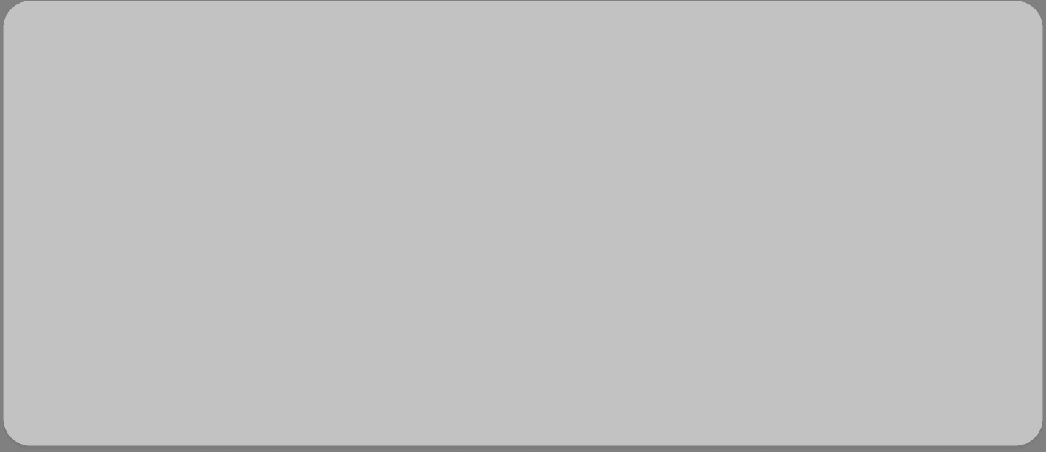



Community Cheat Sheet
Official Documentation
Community Resources
Refer to the official Python documentation for in-depth guides and reference materials. It’s a comprehensive resource for all Python-related queries.
Join Python communities like the Python Discord server and local meet-ups. Engage with fellow learners and experts for support and motivation.

Slide 19

Final Q&A & Next Steps
Q&A and Next Steps
Open the floor for any remaining questions. Share resources for further learning and encourage daily practice to solidify your Python skills.

Slide 20

THANK YOU！
Sean Wong
2025/08/05

